Slide 1

The Court-House
Understanding the Indian Constitution.

Slide 2
ABOUT OUR TOY IDEA
Player acts as a lawyer and chooses what to speak out of given options, there is a situation abstract and law book to help him/her decide what to speak to win the Case.
Overview of Idea
Our Approach towards Idea Development
Schema Select
1
Digital Toy
Fight Against the crime with the Law Book.
Learn, decide and deliver your plea in the Court to win the case.
This is an Internet Browser based game (can be played on pc /mobile), its complete approach is based on HTML + CSS + JavaScript and SVG Animations.
Player is in court as a lawyer representing his/her client, case is explained as the game continues in the “Case Abstract” provided . Also go through the “Law Book” and choose from the given options which one fits the law accurately and deliver it to the jury.
Player gets points if it is correct and finally wins when enough evidences are presented.
2
Indian Culture, History, Knowledge of India and Ethos (TYCH32)

Slide 3
Creating our Toy story
1
How Your Toy is Different From Existing Toys
Describe how your Toy/Game is different form existing games in the market and how you are going to commercialize it? (Not More Than 500 Words)
This Game reflects a unique scenario which will be very helpful for young children specially to instill Our Constitutional values in a fun and interactive way. This will teach them basic rules and regulations and their respective penalties on various criminal cases. Children will understand the values of our constitution in a professional manner where they are virtually present in a court and are fighting against the crime by choosing what is right after reading the Case Abstract and also the Law book. They will have to represent their plea based on laws in our Constitution that is stated in the Law Book, if they fight ethically with proper understanding of the situation and laws they will be scored and will win the case or will certainly lose it. The whole idea behind this game makes it unique and will be really helpful in boosting ethics amongst children. This is an Education based Game so can be commercialized with the help of Educational Institutes. While teaching the constitution preferring this game to the students will be benefitted to them. This will surely create their interest in knowing more and will initiate them to do good for our Society.
2
Does Your Toy Reflect Indian Culture, Ethos, Ayurveda, Diversity or Psychology
Tell us in detail how your toy cover the theme you’ve selected. Ne more specific towards crux or conclusion
Our Game reflects Ethos
The Court-House Game aims to inculcate (specially amongst young children) our constitutional values .The Constitution is often treated as an oath-taking relic in parliament or just a goulash of complicated terms in school textbooks nowadays and this is somewhat lacking and needs to be worked upon, so with this aim we would like to initiate in creating awareness amongst young lads about our great constitution its amendments, basic tenants, rules, punishments and penalties.
It’s not just about Constitutional knowledge but also creating a Court based environment where player will be encountered to a Virtual Court with Realities…
This will not only help them in gaining knowledge but also will be a lot of fun, children could also cultivate interest in LAW and will further help them in contributing to our Society.
This will help them in becoming law abiding citizens and doing what is right and also cultivating Responsibilities towards our society.

Slide 4
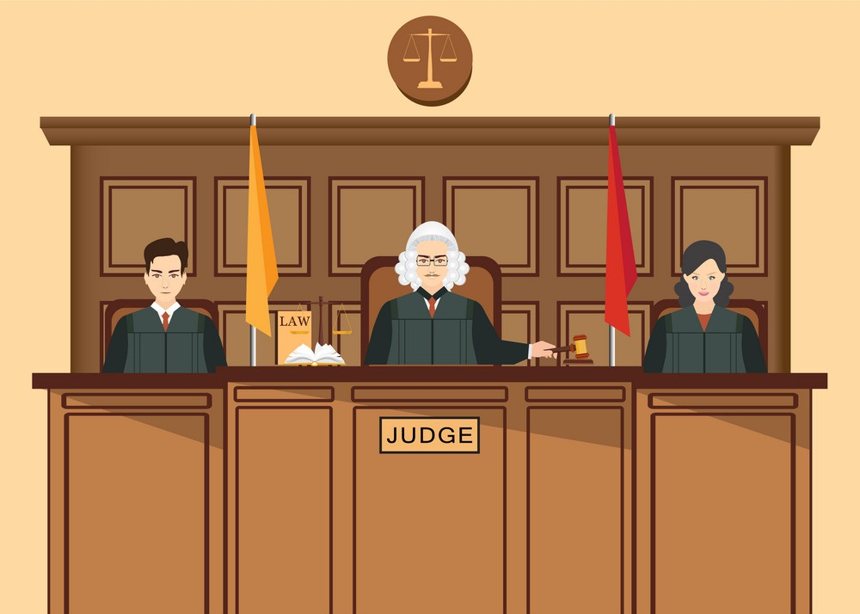


SOME CREATIVES
Law Book:
Section 300: The Act is commenced with the intention of causing bodily injury which…
Evidence report says…
Are we all ready to proceed?

Slide 5

Team Profile
Team Objective
To build a game that reflects values of the Constitution of India. To build the sense of law and justice among children by developing their interest and a will to learn more about laws in India.
Team Details
Team Name
Team Name: Excellence
Team Leader: Manan Gupta, 9758183355, manan.gupta.cs.2018@miet.ac.in
Team member: Ananya Sharma, 9536873941, ananya.sharma.cs.2018@miet.ac.in
Team member: Samarth Anand, 7060226350, samarth.anand.cs.2018@miet.ac.in
Team member: Samarpan Jain, 8941837344, samarpan.jain.cs.2018@miet.ac.in
Team Size: 04
Mentors: Dr. Mukesh Rawat, Dr. Vimal Kumar
College: Meerut Institute of Engineering and Technology
Type: Digital

